Slide 1
High-Level Text to image: Transforming description into visual art.
Presented by :-
-sidhdhraj (U20CS057)
-venkataramana(U20CS082)
-Swapnil(U20CS058)
-Dinesh(U21CS114)

Slide 2
Overveiw
Introduction
Importance
Abstract
Motivation
Objectives
Methodology& Results
Benefits
Challenges
Future work
Conclusion

Slide 3
Introduction:-
Definition:-
Text-to-image generation is a process where a model creates visual images based on textual descriptions.
This technology leverages advanced neural networks, particularly transformers, to interpret and transform text into corresponding images.
The process involves encoding the text into a format the model can understand and then decoding it to generate the image.
This allows for the creation of detailed and accurate images from simple text inputs, enabling new forms of creativity and automation in various fields such as art, marketing, and entertainment.

Slide 4
Importance:-
Text-to-image generation is significant in AI and visual art because it enables the creation of images from simple text inputs, fostering new forms of creativity and automation.
This technology democratizes the creative process, making it accessible to those without advanced artistic skills.
It also drives innovation in fields like marketing, entertainment, and content creation by providing a powerful tool for visual storytelling.

Slide 5
Abstract:-
Plain text is commonly used for text-to-image synthesis, but it has limitations in customization.
It’s difficult to specify precise details like RGB color values or the importance of each word.
To address these challenges, we propose using a rich-text editor that supports various formats such as font style, size, color, embedded images, and footnotes.
This approach allows for local style control, explicit token reweighting, precise color rendering, and detailed region synthesis through a region-based diffusion process.
Our method outperforms existing techniques, making image generation and editing easier and more accurate.
Key Words:-
Text-to-image generation, diffusion model, image editing, generative models .

Slide 6
Motivation:-
There is a growing demand for more intuitive ways to interact with AI-based text-to-image generation models.
Existing methods often rely on plain text, which is limiting for specifying details like colors and layouts.
This project aims to use rich-text editors to provide precise and customizable control over image generation, making it more accessible for users.
Goals:
Bridge the gap between creative intent and technological capability.
Empower users to easily translate ideas into visuals.
Enhance applications in art, education, marketing, and design.

Slide 7
Objectives:-
Enhance Customization in Text-to-Image Generation Develop a method to incorporate rich-text attributes (font style, size, color, embedded images) for precise control over image generation.
Ensure generated images align closely with users' creative intentions.
Provide a more intuitive and flexible interface for user interaction with AI models.
Manage color, style, and layout better, resulting in detailed and contextually relevant images.
Facilitate Real-Time Image Editing.

Slide 8
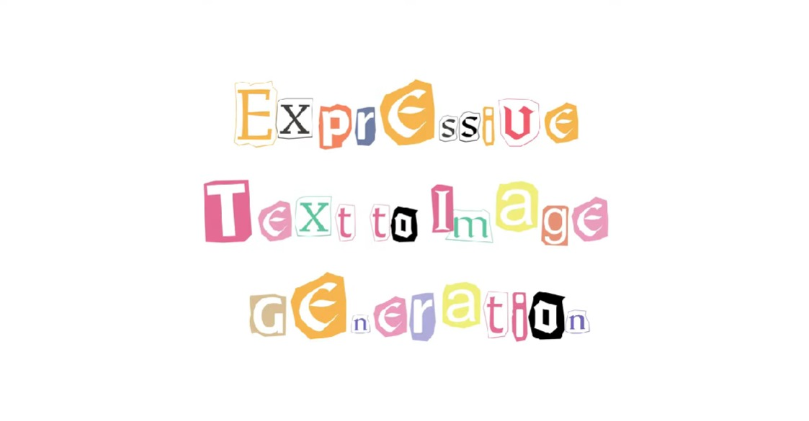

Slide 9
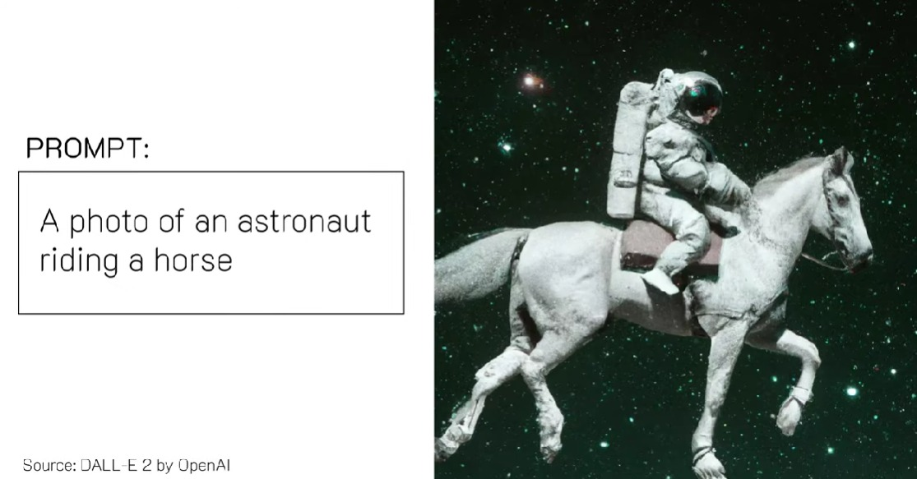

Slide 10
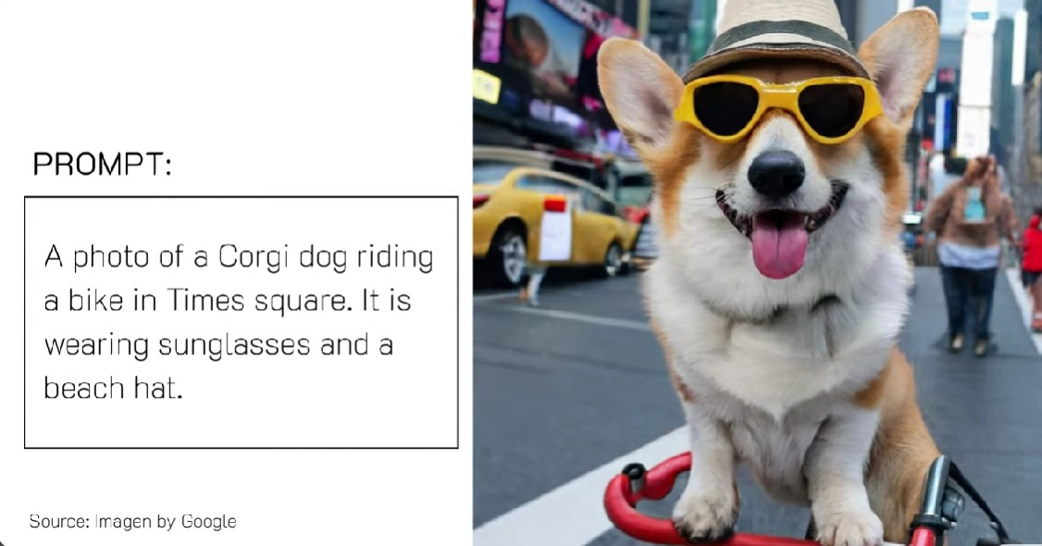

Slide 11
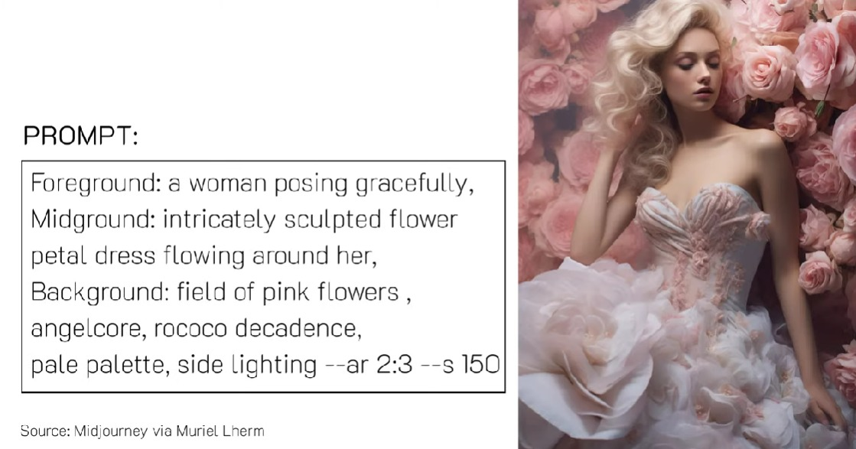

Slide 12
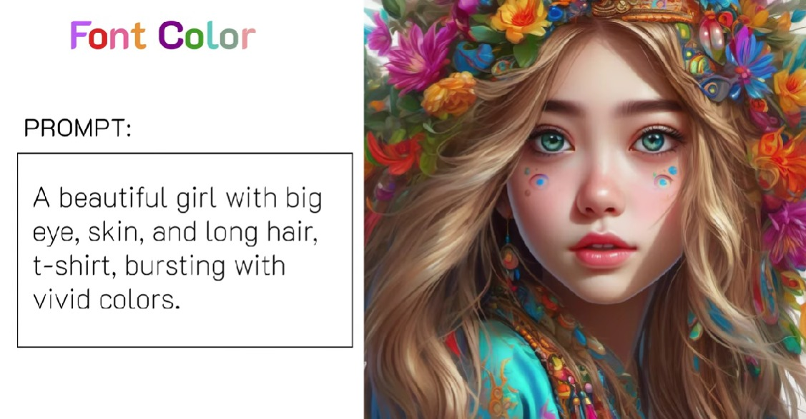

Slide 13
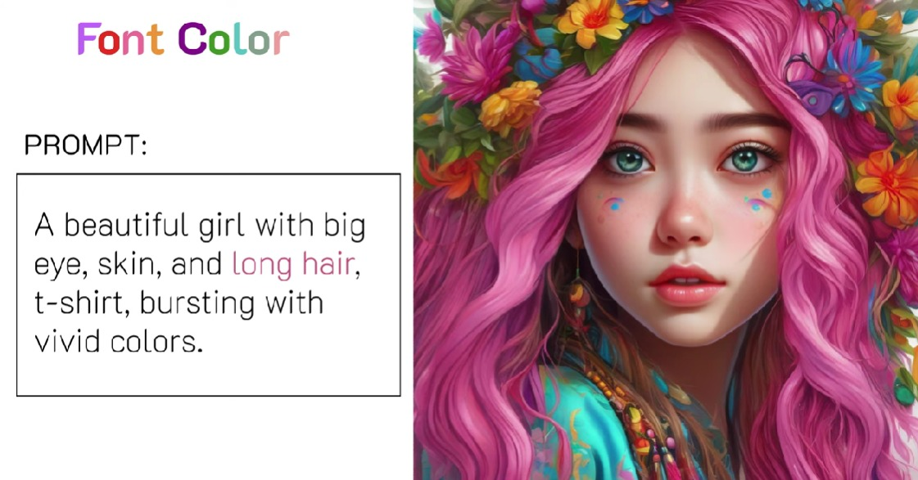

Slide 14
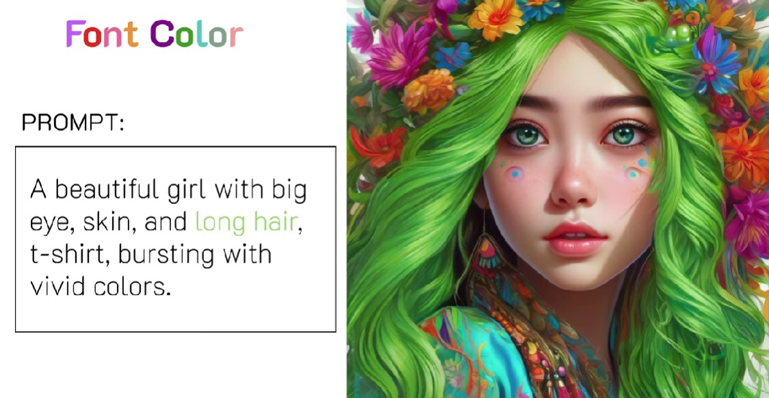

Slide 15
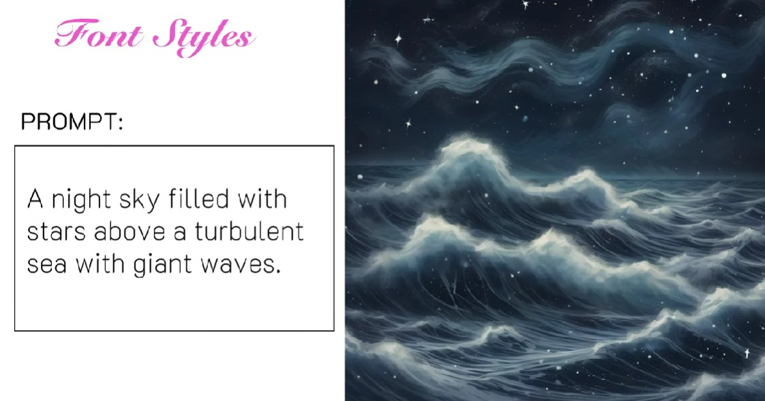

Slide 16
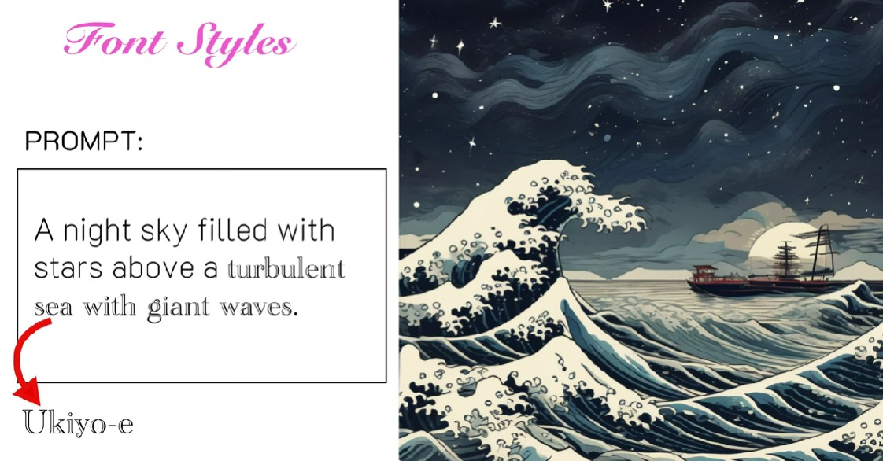

Slide 17
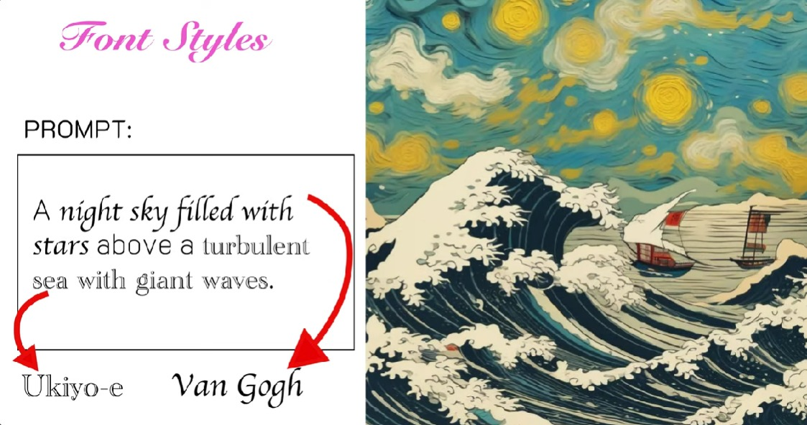

Slide 18
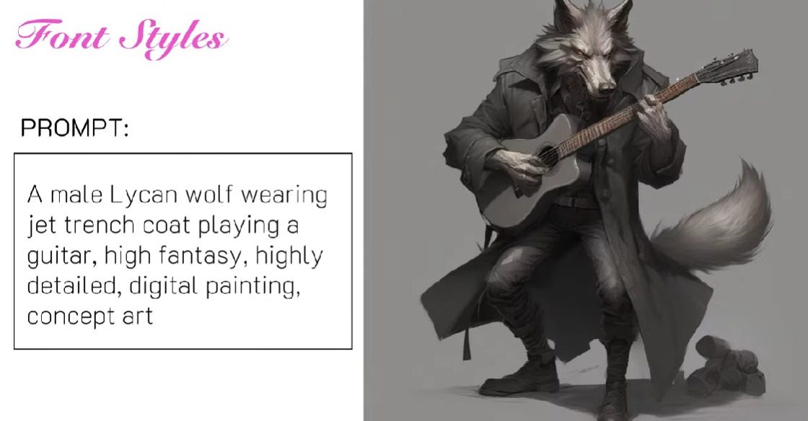

Slide 19
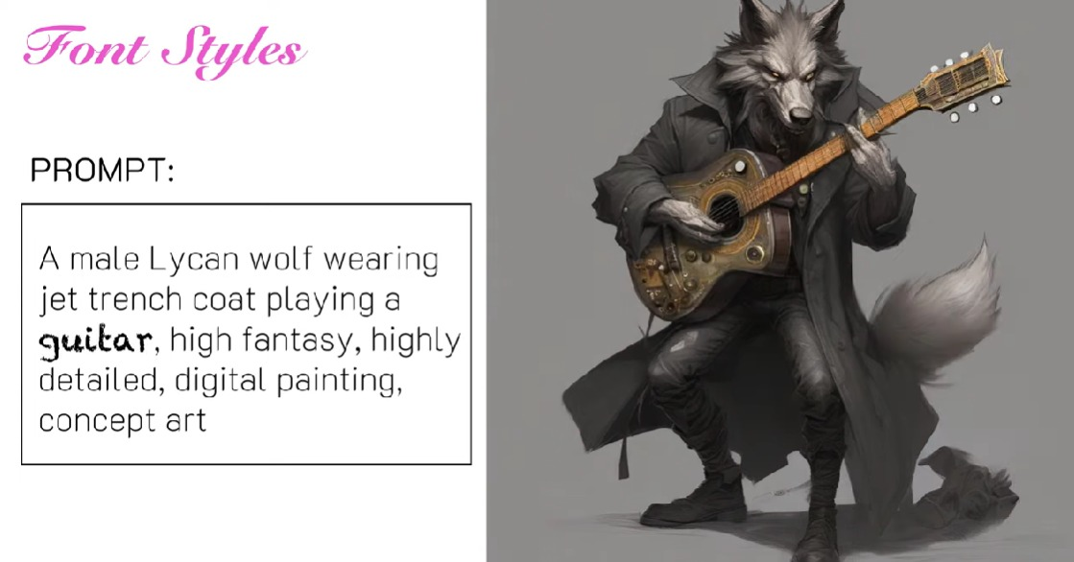

Slide 20
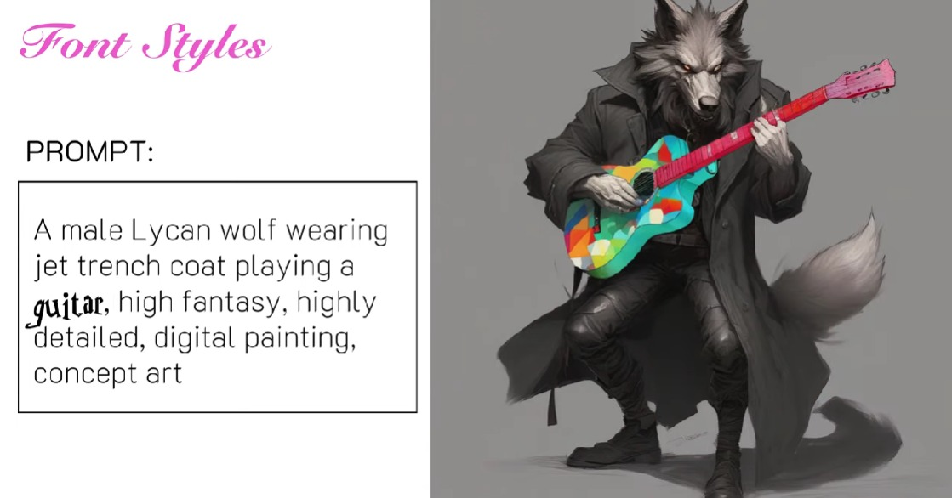

Slide 21
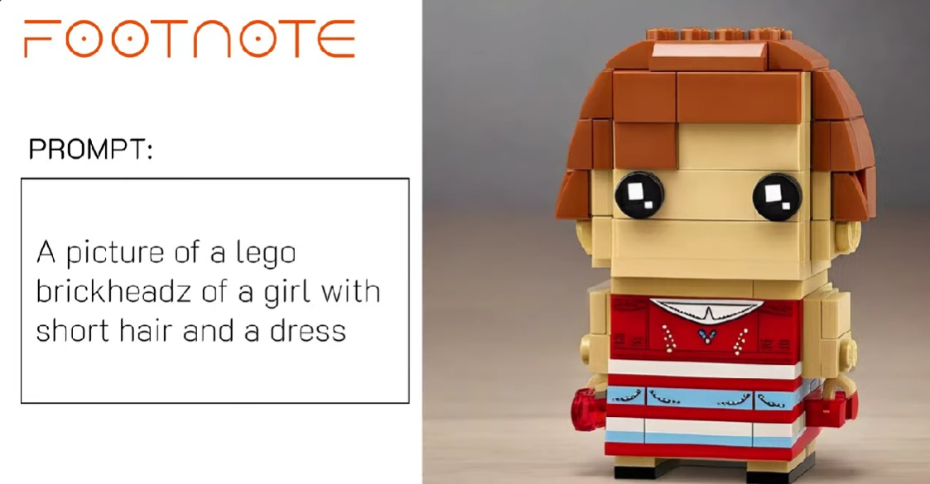

Slide 22
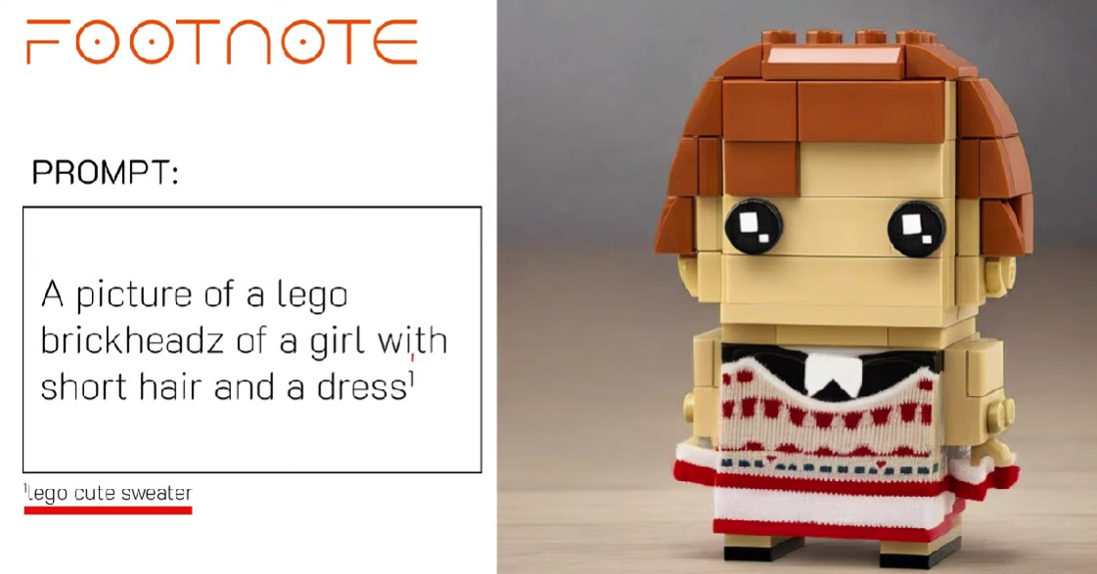

Slide 23
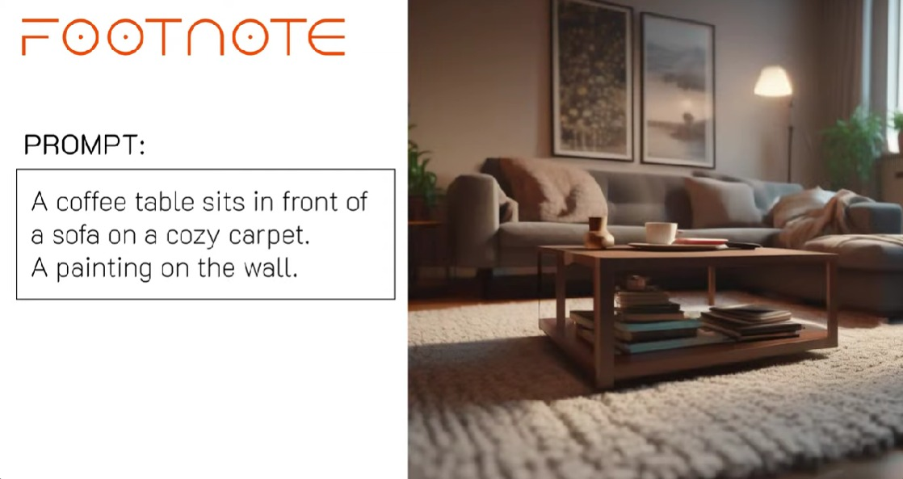

Slide 24
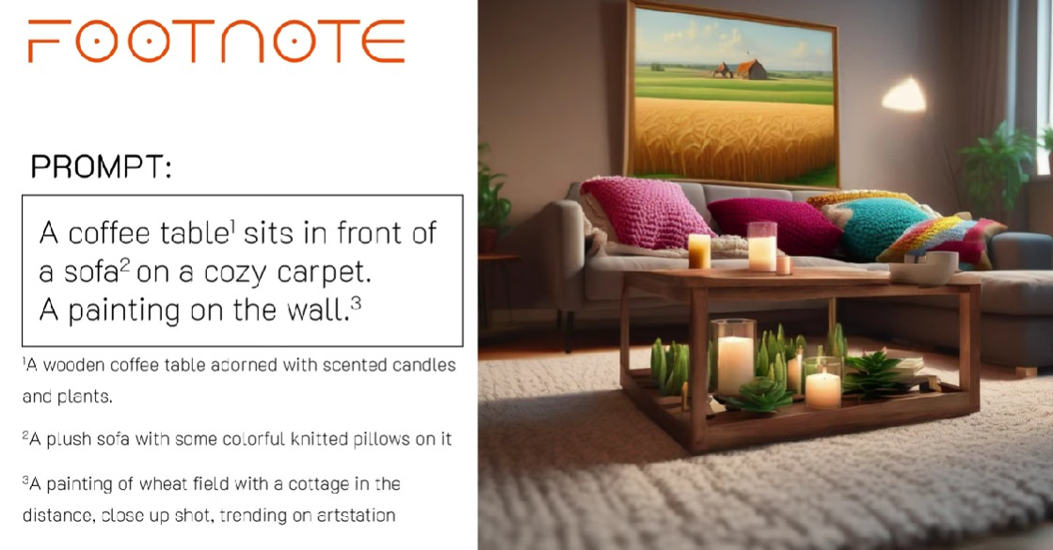

Slide 25
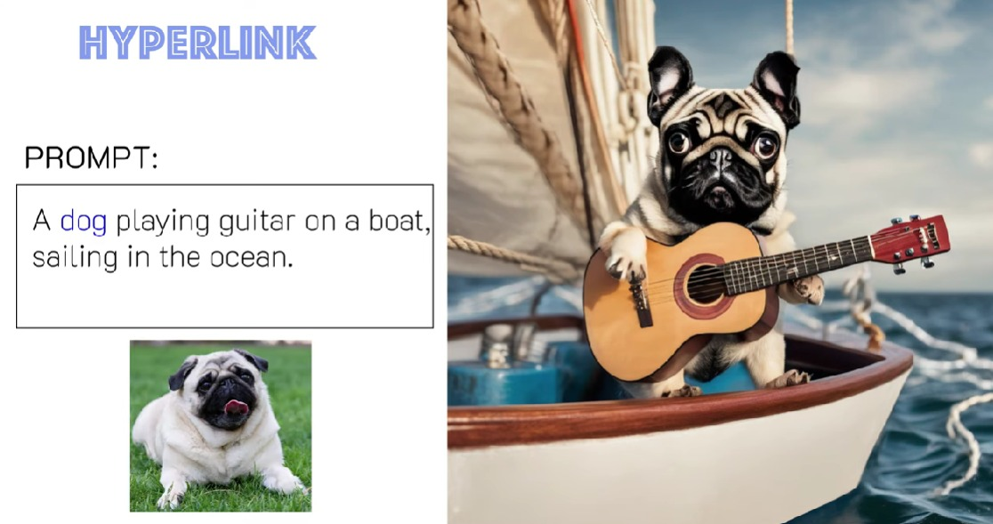

Slide 26
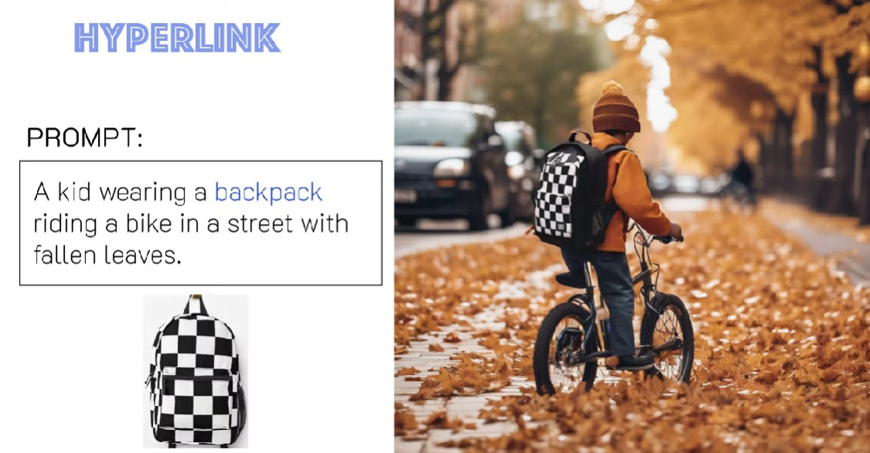

Slide 27
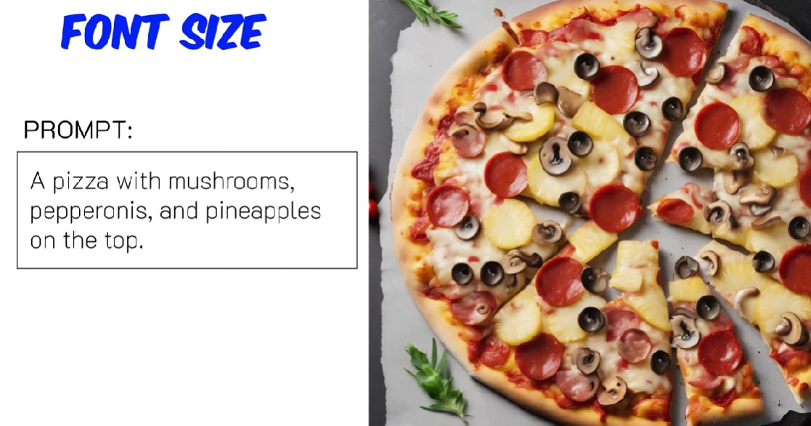

Slide 28
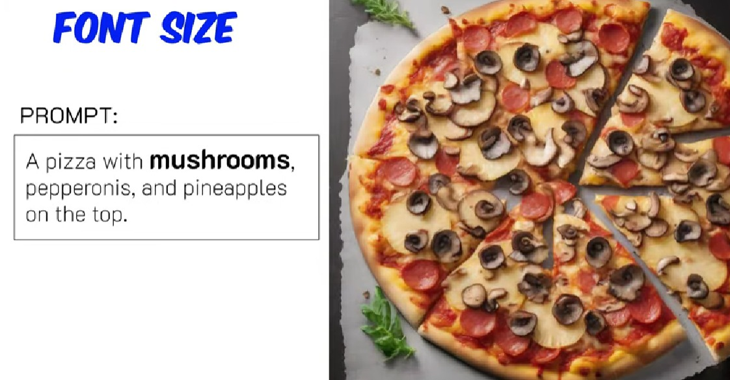

Slide 29
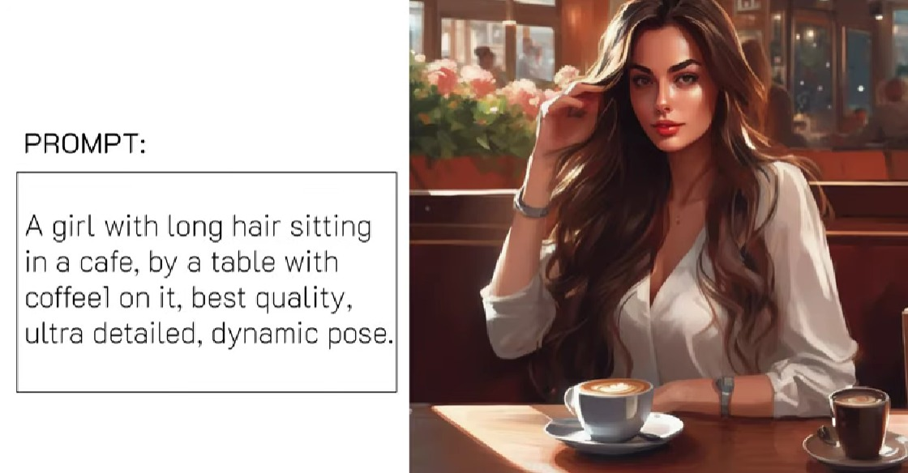

Slide 30
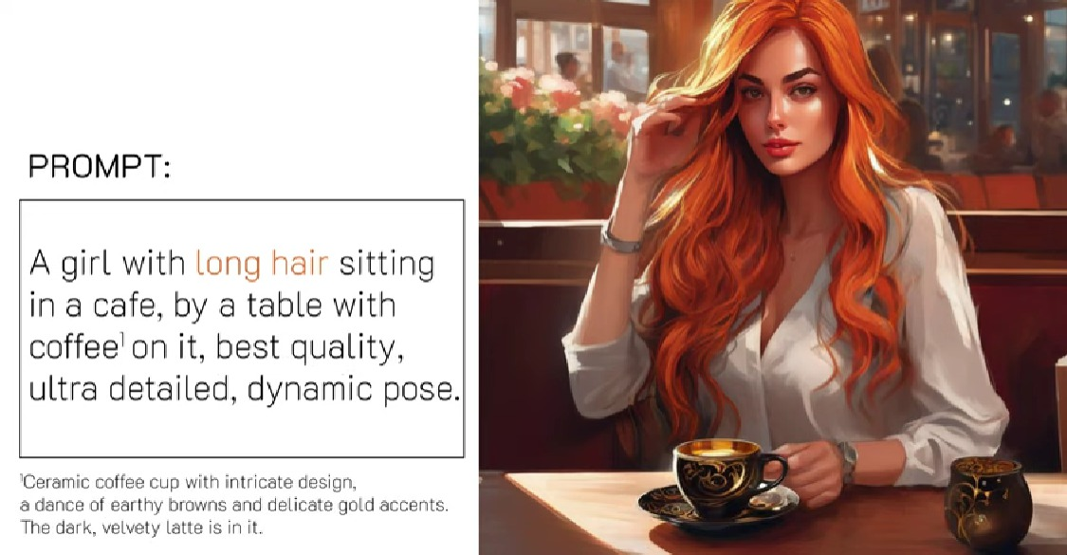

Slide 31
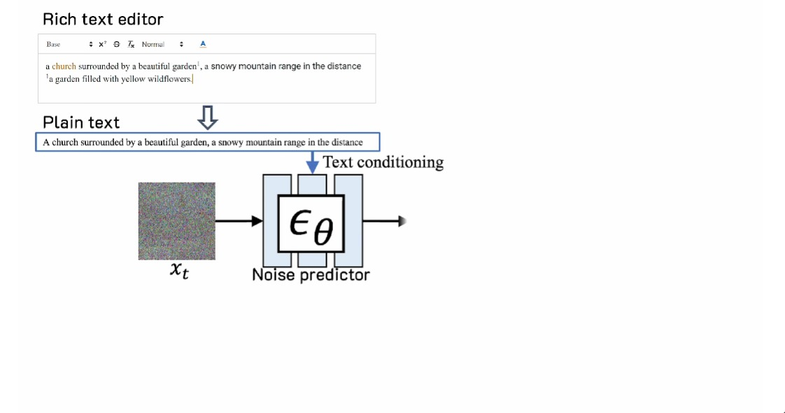

Slide 32
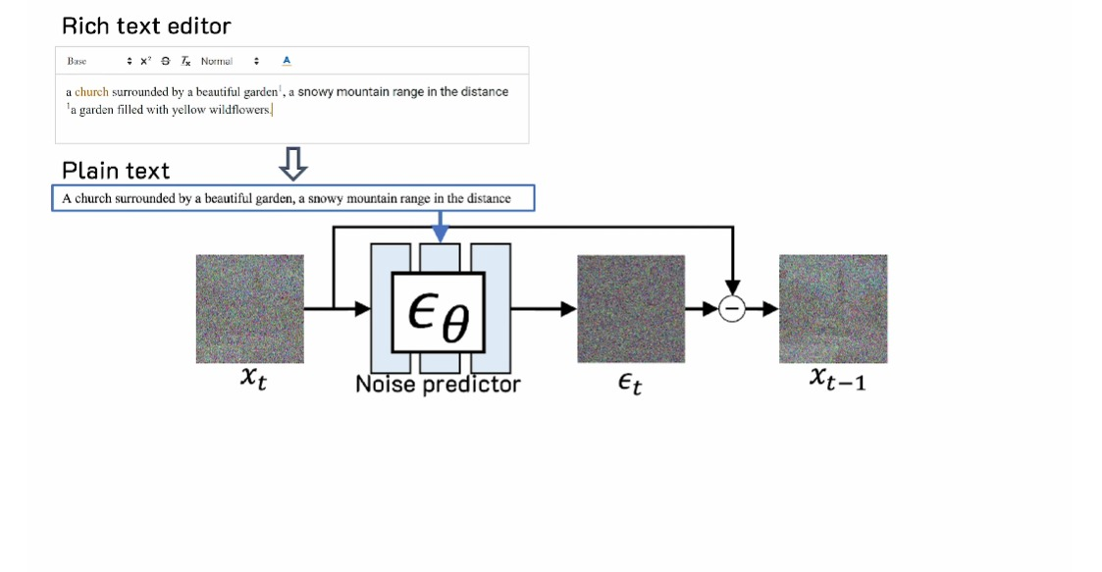

Slide 33
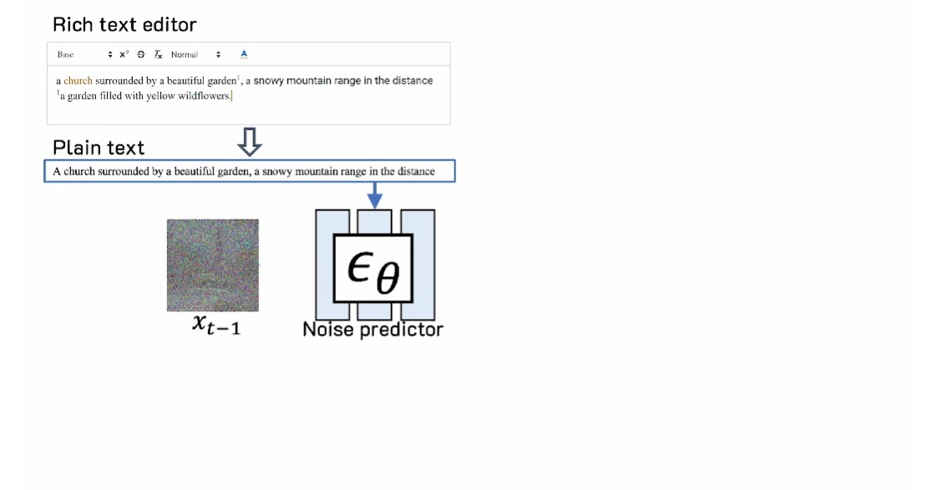

Slide 34
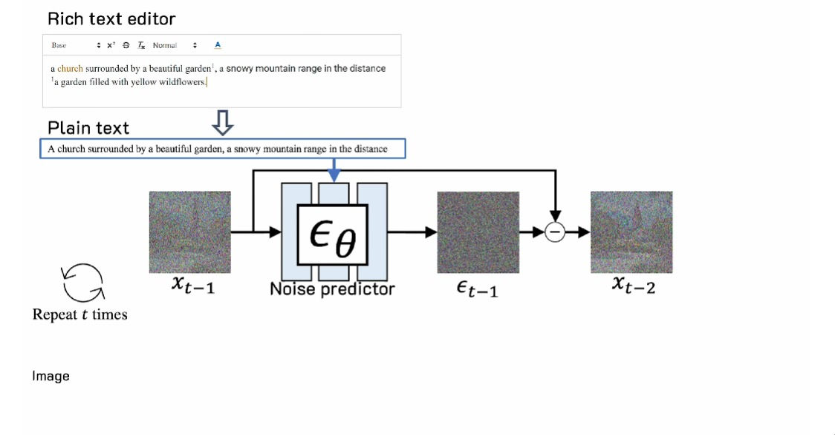

Slide 35
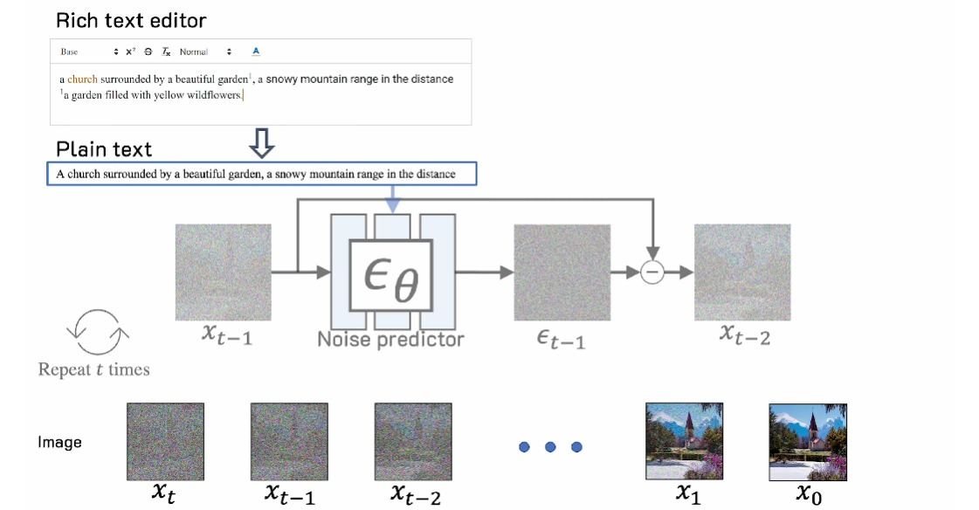

Slide 36
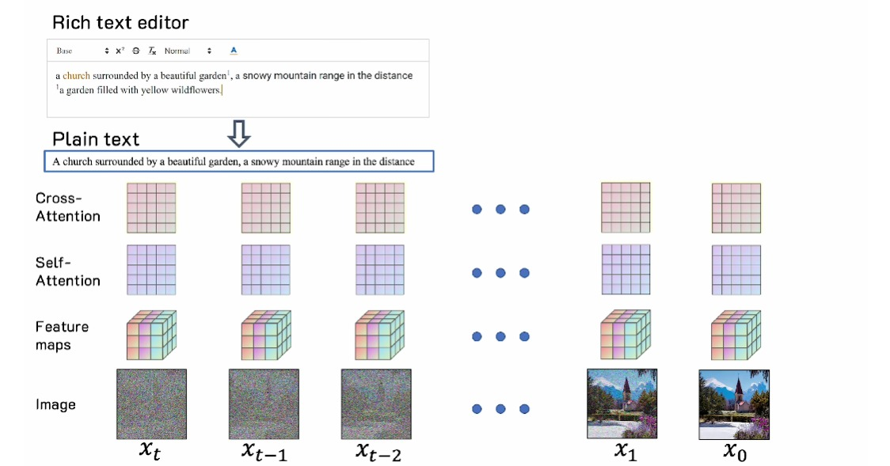

Slide 37
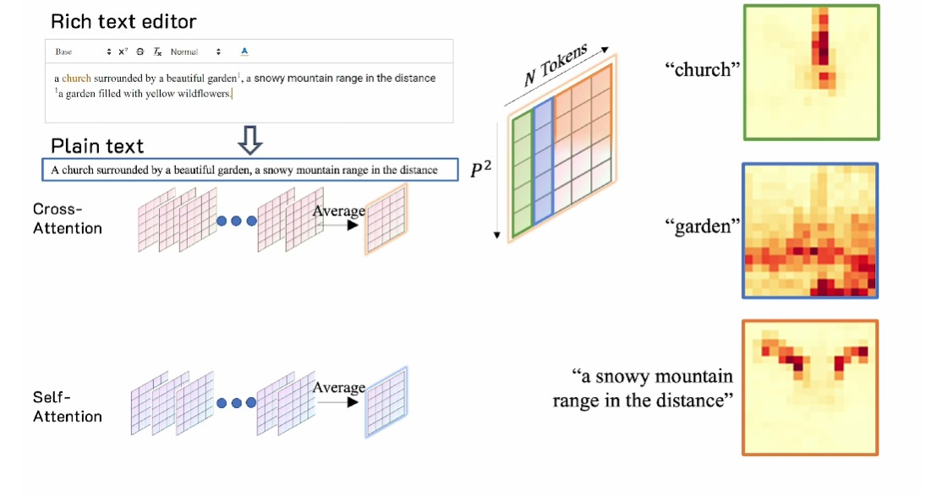

Slide 38
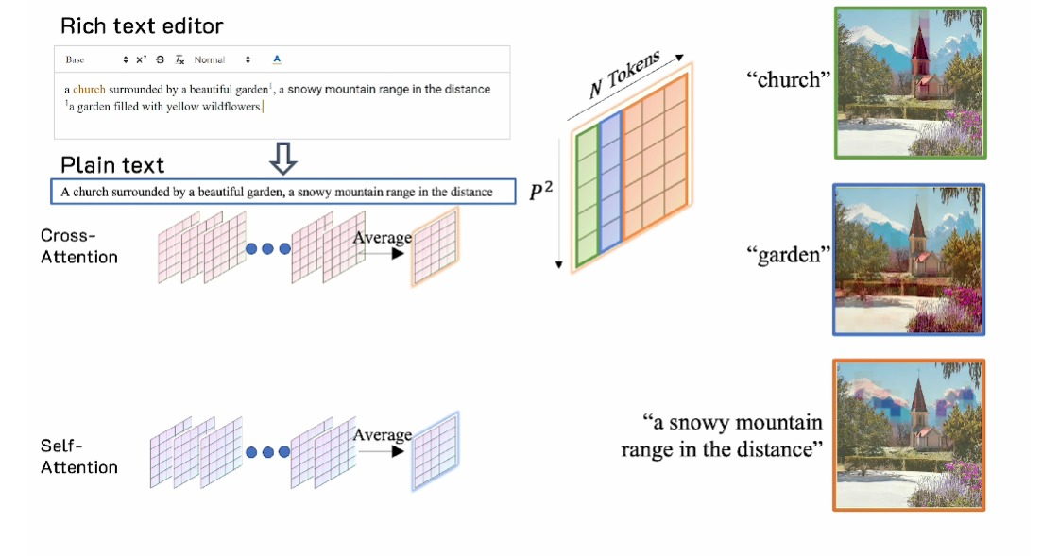

Slide 39
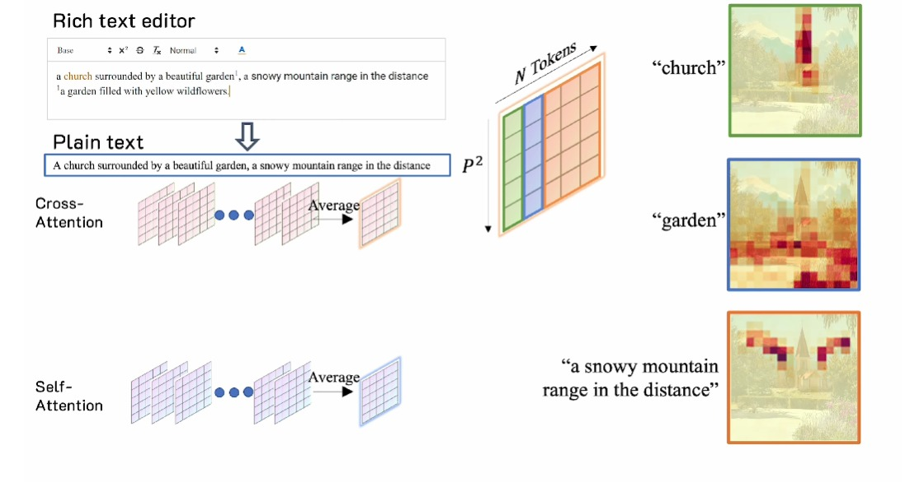

Slide 40
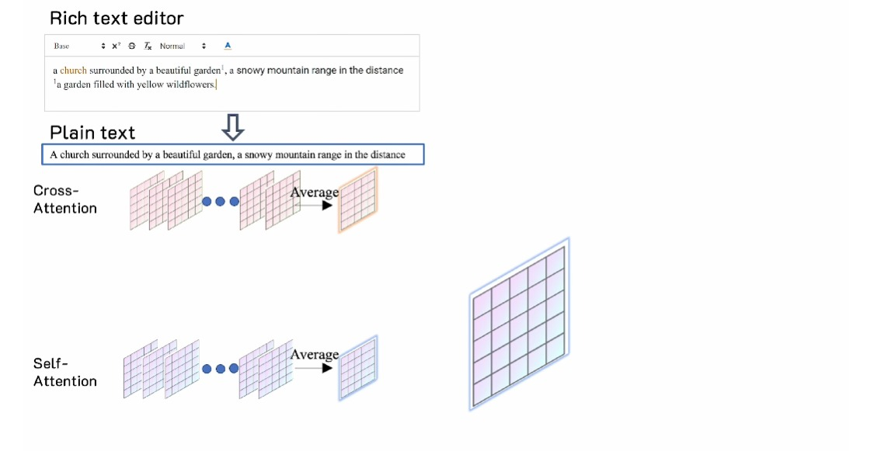

Slide 41
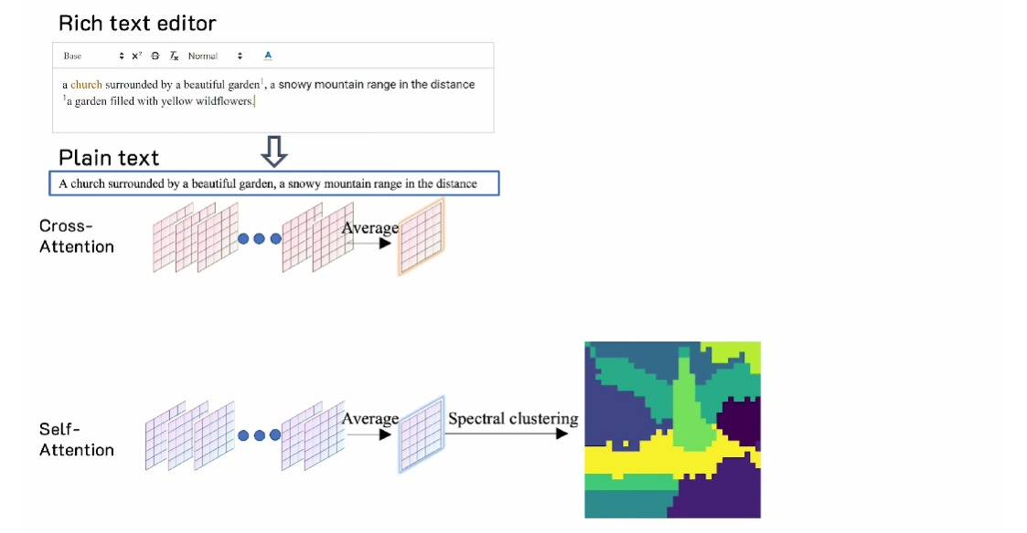

Slide 42
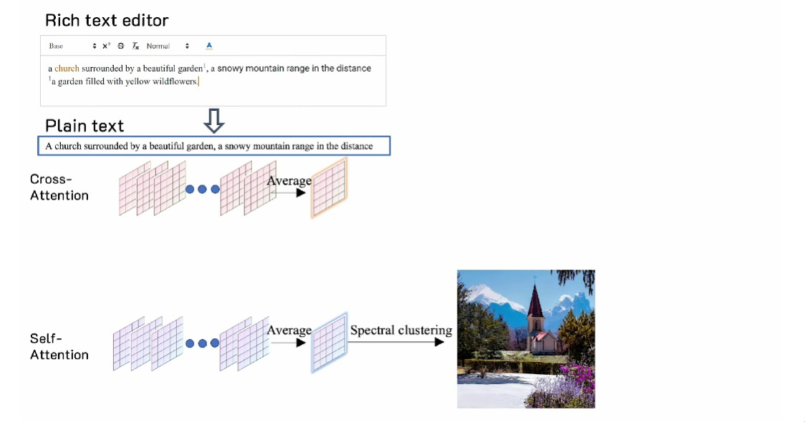

Slide 43
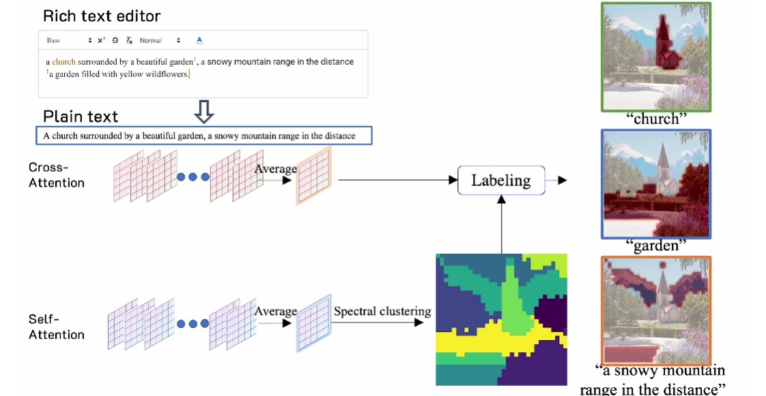

Slide 44
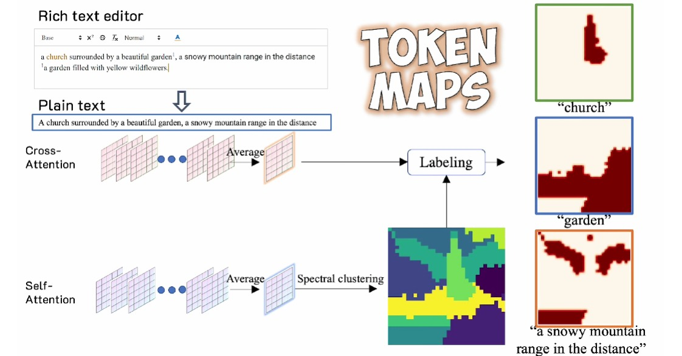

Slide 45
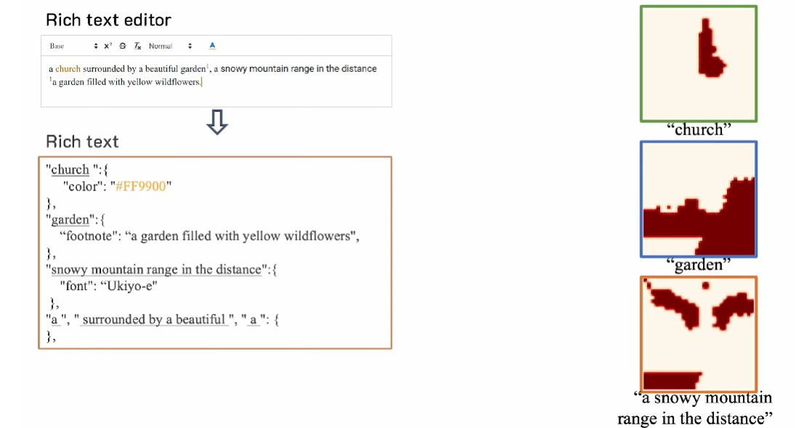

Slide 46
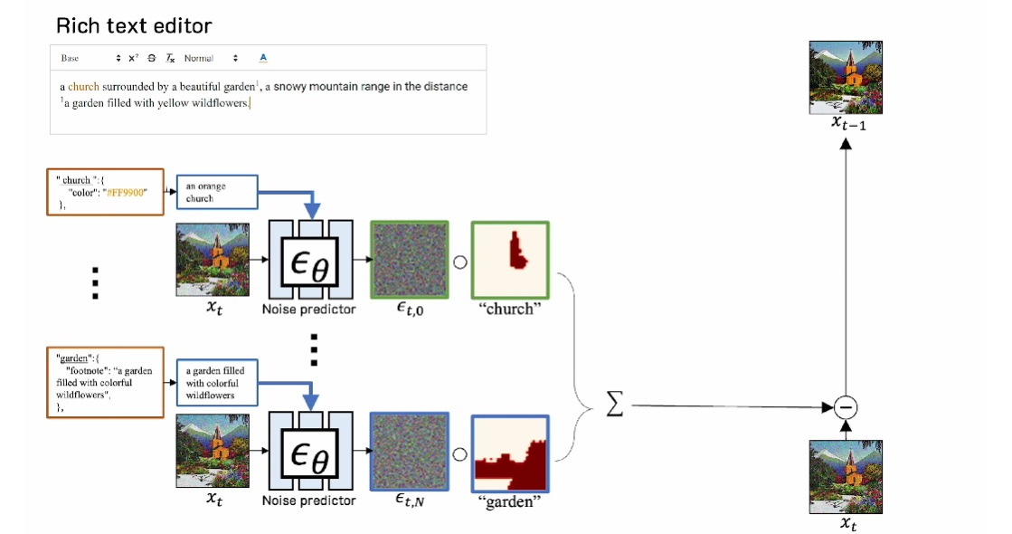

Slide 47
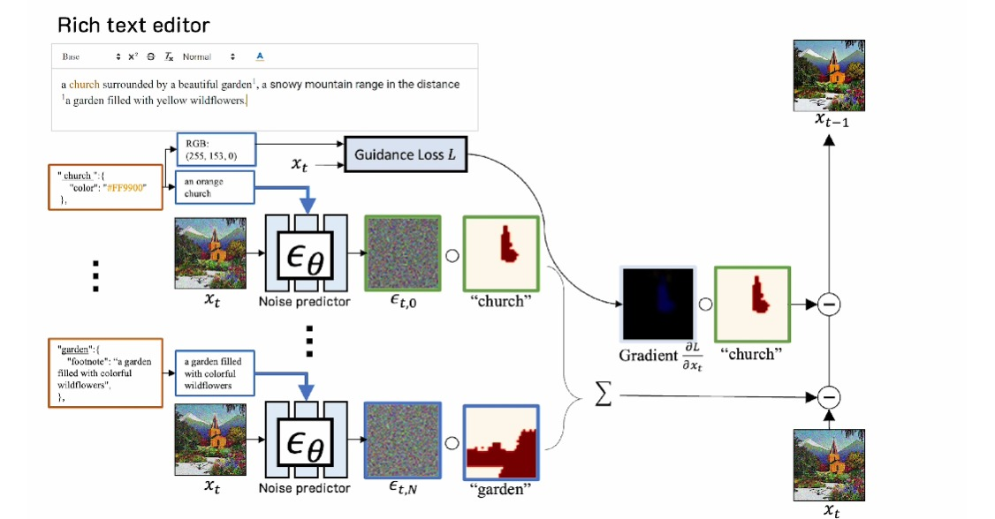

Slide 48
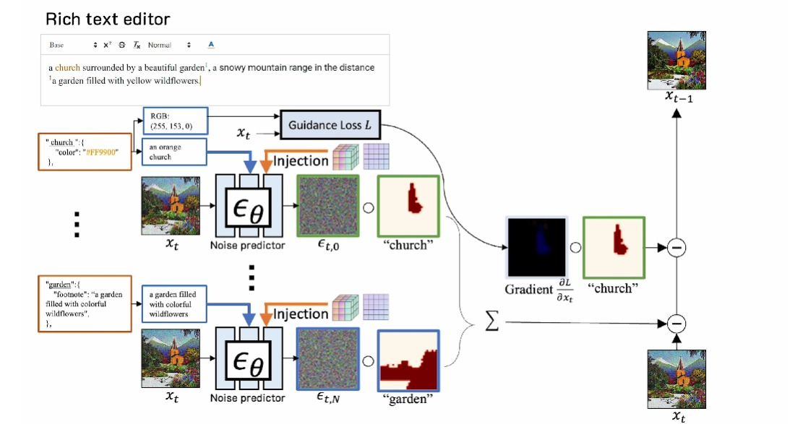

Slide 49
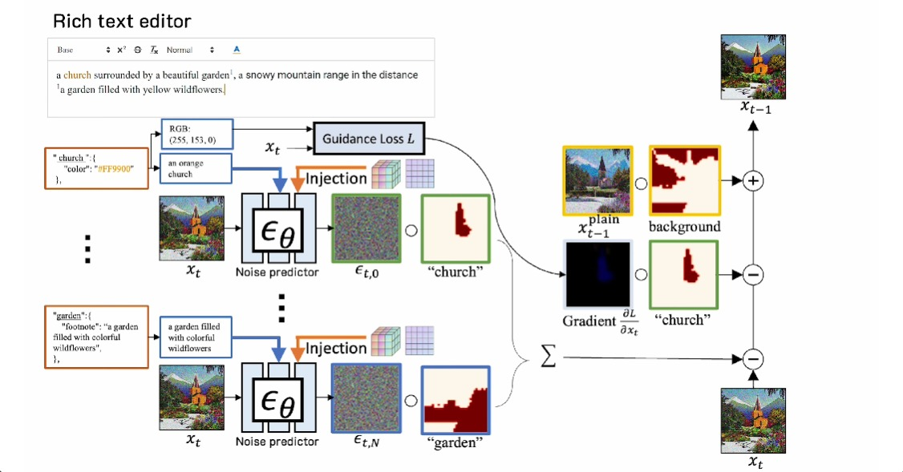

Slide 50
Benefits :-
Ease of Use: This approach simplifies the process of generating and editing images by allowing users to customize text with attributes like font size, style, color, and embedded images.
Quality: The use of rich-text inputs leads to higher quality and more detailed images.
Customization: Rich-text inputs provide greater control over the final image, allowing users to specify exact details such as colors, styles, and emphasis on certain words.
Efficiency: The ability to include detailed formatting in the text input reduces the need for extensive post-processing and manual adjustments, saving time and effort.

Slide 51
Challenges:-
Limitations:-
Plain text makes it difficult to specify exact details like colors, the importance of certain words, or complex scene layouts.
For example, it’s challenging to define precise RGB color values or emphasize specific words.
Additionally, creating detailed text prompts for complex scenes is tedious and often leads to less accurate image generation.
These limitations hinder users from accurately describing their desired outputs, making the process less efficient and effective.

Slide 52
Future Work:-
Expand Rich-Text Attributes :- | Incorpaorate Multimedia Elemenets:- | Enhance VR/AR Contents | Handle Complex Attributes Interaction
Rich text attributes enable a wider range of formatting options,including inline styles,paragraph styles,and even custom attributes | Multimedia, including videos, animations, and 3D models, adds depth and interactivity to digital documents. | Virtual and augmented reality content provides immersive experiences, allowing users to interact with virtual environments and objects in a more realistic way | Complex attribute interactions require careful handling to ensure that different styles and colors are applied correctly and in a predictable way.

Slide 53
Conclusion:-
This project presents a significant advancement in text-to-image generation by leveraging rich-text inputs to provide users with more precise control over the generated images.
By incorporating attributes like font style, size, color, and embedded images, the proposed method allows for a level of customization that is difficult to achieve with traditional plain-text prompts.
The region-based diffusion process ensures that these rich-text features are accurately represented in the generated images, leading to improved image quality, more distinct details, and better alignment with user intent.
This approach not only enhances the flexibility and usability of text-to-image synthesis but also lays the foundation for more personalized and intuitive creative tools in the future.

Slide 54
THANK YOU

